Slide 1
Linkedin Job data analysis and insights
BUAN6340 – Programming for Data Science
By: Sachin Jain
Net ID: SXJ230042

Slide 2
Overview
01
04
02
05
03
Motivation
Exploratory Data Analysis
Introduction & Data Description
ML Model Selection & Building
Data Collection & Preprocessing
06
Results

Slide 3
Why this data?
Application beyond the coursework
Timeliness and Relevance
Immense Potential
Richness of data
Is AI taking away our jobs?
Did COVID create a new “Remote work job trend”?

Slide 4
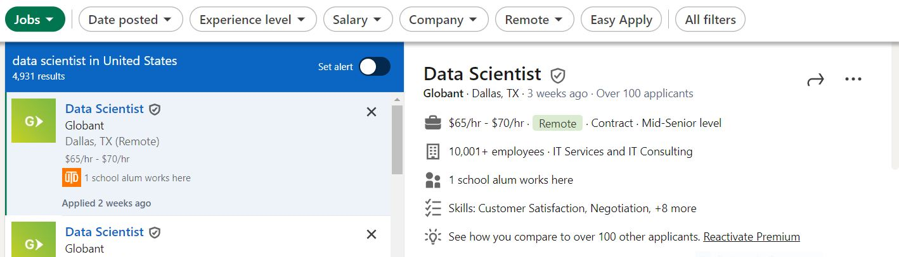
Introduction to the Data
Collected from – Linkedin Job postings

Slide 5
Introduction to the Data
Data Collection & Cleaning
Data Scraping: The dataset was initially collected by scraping job postings from LinkedIn about 6 months ago
Data Aggregation: After scraping the data from LinkedIn, it was aggregated into a structured format suitable for analysis
Data Cleaning: The dataset was examined, missing values were identified and treated, and data quality was evaluated. Redundancies are eliminated to prevent bias in the analysis
Data Description
There are 20k+ rows and 22 columns in the dataset
Columns like Sponsorship, min/max salary, no of applications, job title, job location, remote allowed and more

Slide 6
Data Process
Data Preprocessing
Data Collection
Exploratory Data Analysis
Model Building
Prediction & Insights
Completed
Pending

Slide 7
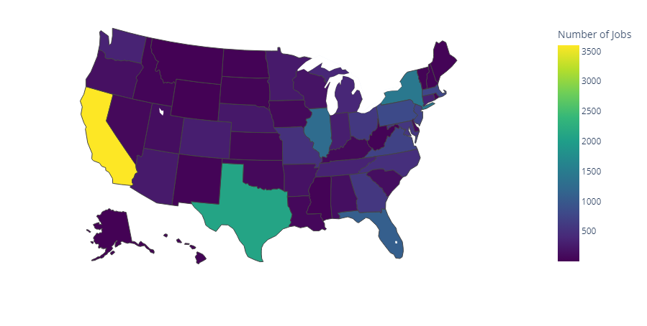
EDA around Location (states)
Jobs Distribution by States in the United States

Slide 8
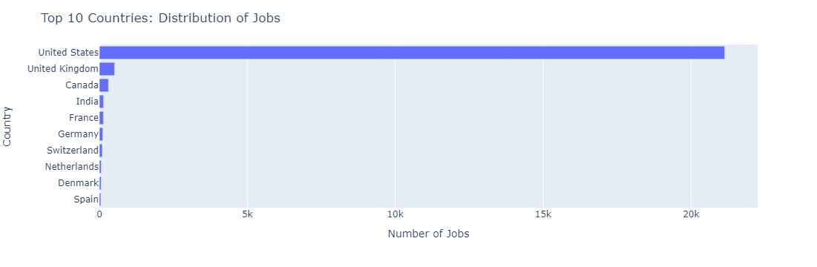
EDA around Location (countries)
This chart succinctly portrays the top 10 countries with the highest job postings, offering a clear insight into the distribution of employment opportunities on the basis of country.

Slide 9
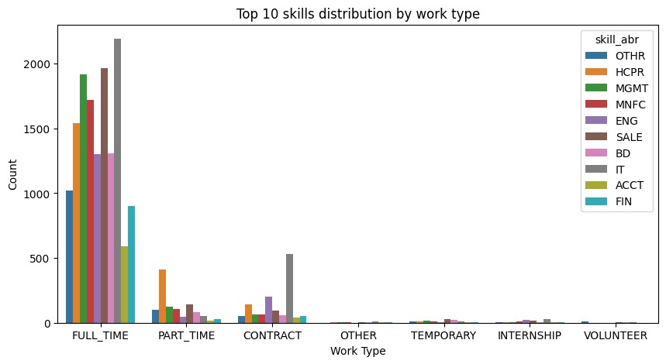
EDA of skills by work type
Distribution of skills by the work type (i.e Full time, part time, etc)

Slide 10
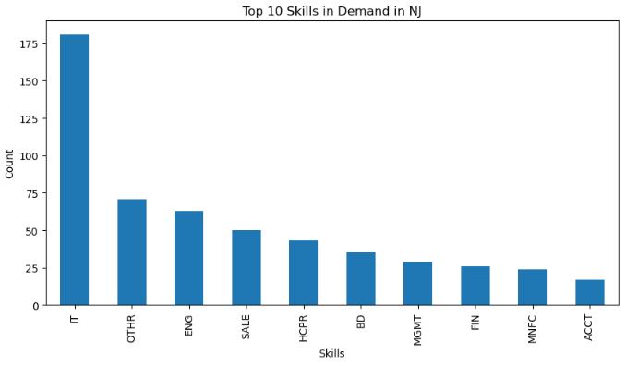
EDA of skills in a particular location
Top skills in demand in a particular location (can be altered as per need)

Slide 11
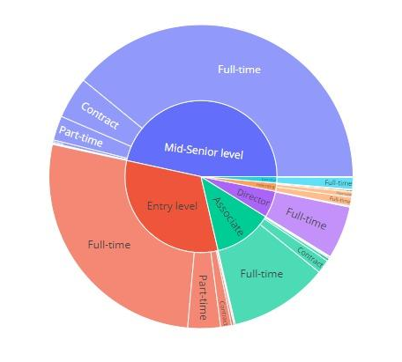
EDA around companies
This sunburst chart is particularly useful for exploring the distribution of job postings across different experience levels and work types in a hierarchical manner.

Slide 12
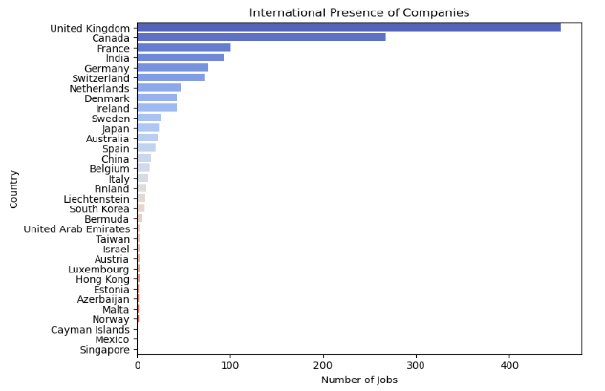
EDA around companies
This chart helps in understanding the international reach of companies and potential areas of interest for job seekers or businesses looking to expand globally.

Slide 13
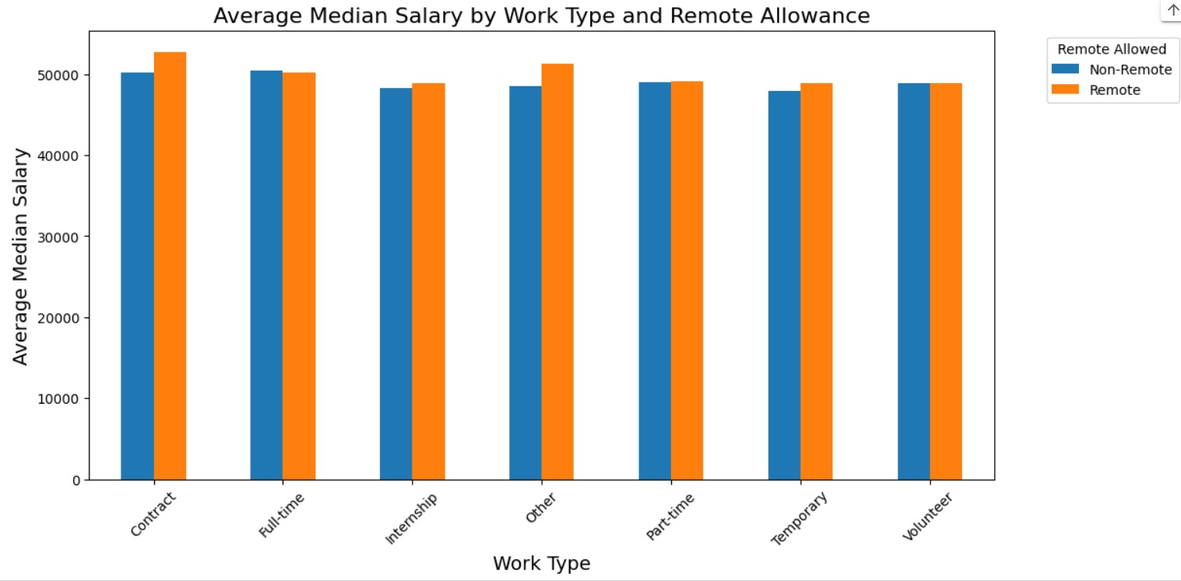
EDA of Salaries
This grouped chart effectively highlights salary variations across different work types and remote work options, offering insights into how these factors interact to affect salary levels. ​

Slide 14
Target Outcomes
I aim to construct a regression model designed to address the following inquiry:
What factors influence the number of applications (dependent variable) for a particular job?

Slide 15
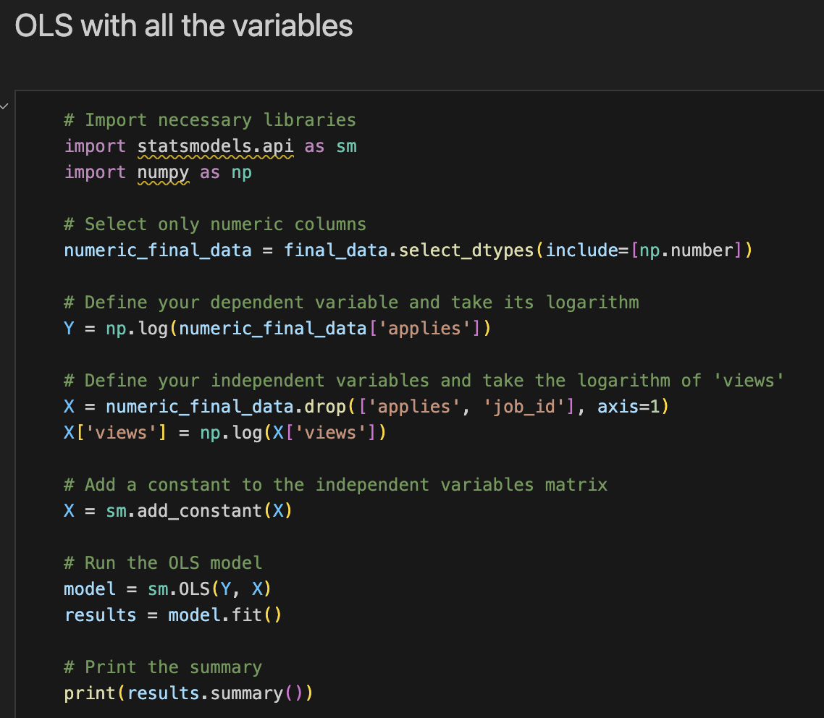
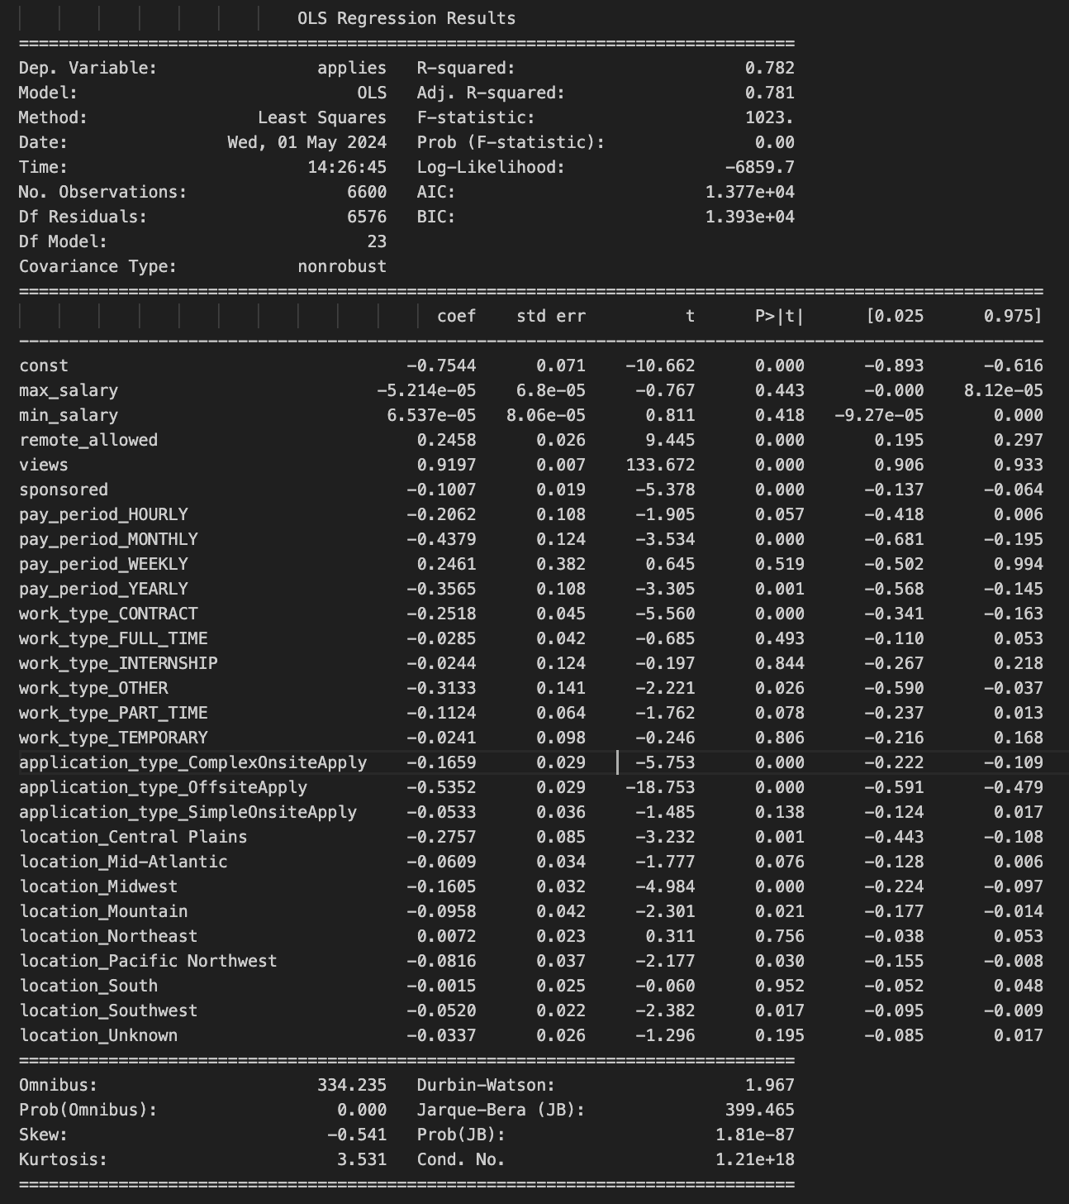
OLS Model – Feature Selection

Slide 16
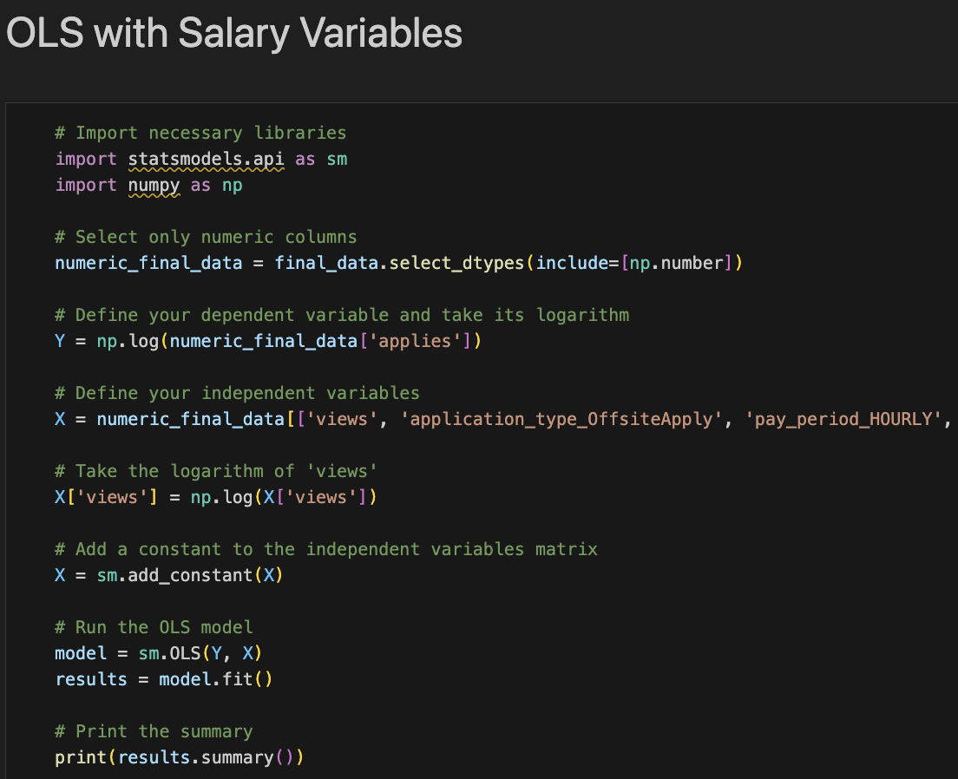
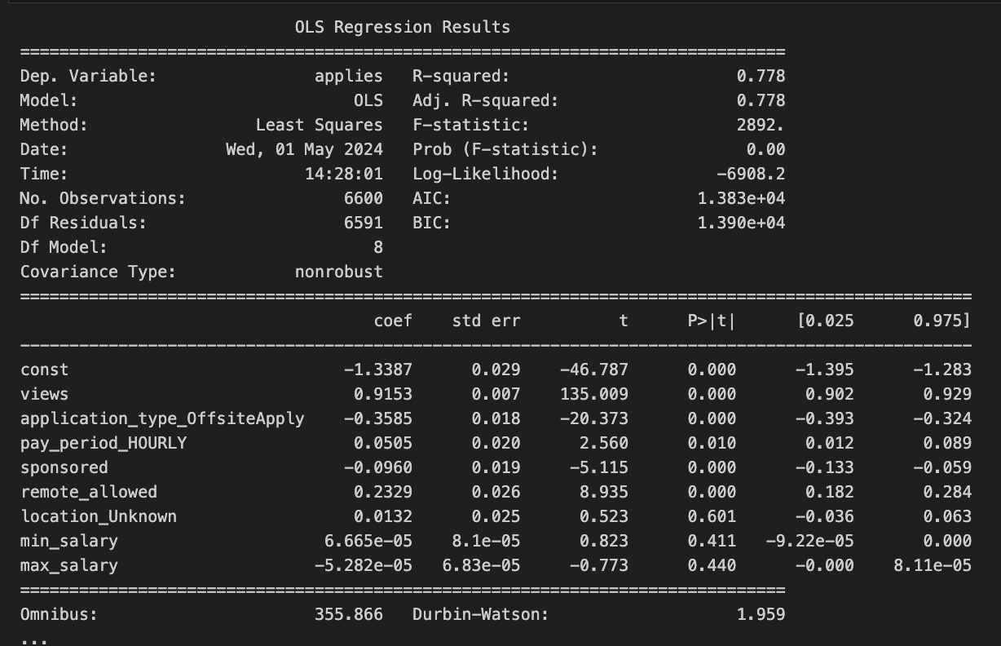
OLS model with manually selected variables

Slide 17
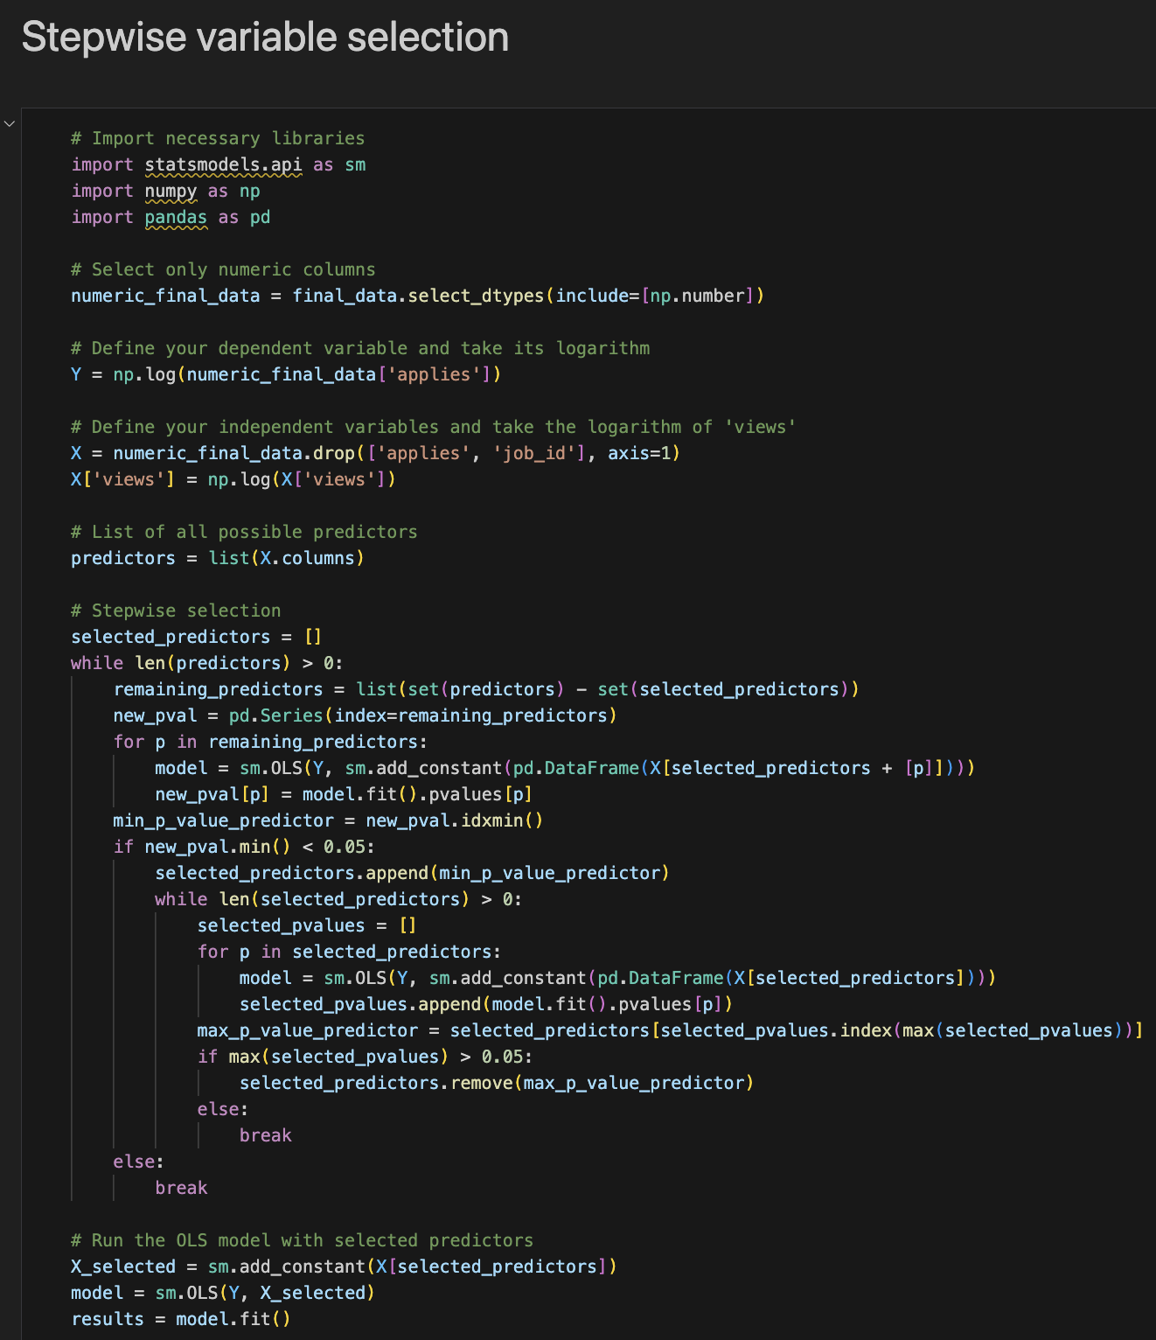
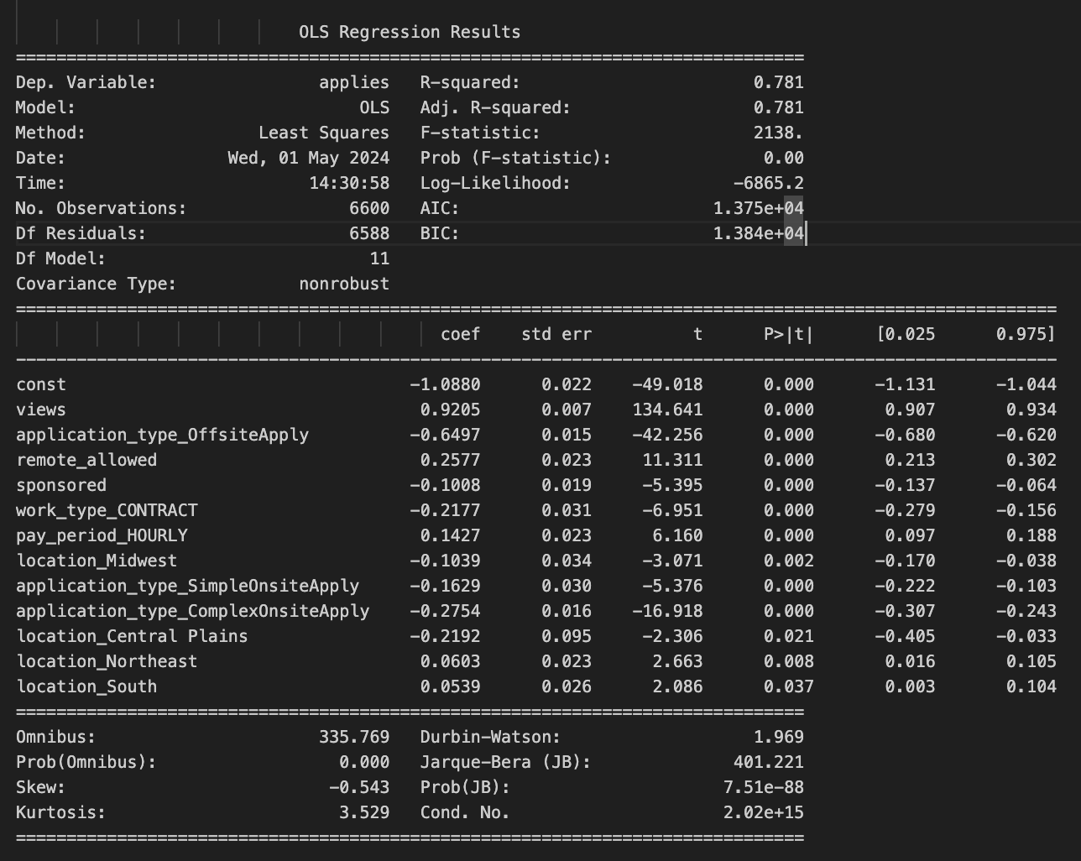
Stepwise Model
Final Model

Slide 18
Feature Selection Output
Category | # of features
Initially | 17
One-Hot encoding | 26
OLS model | 26
Manually Selected Variables | 8
Stepwise | 12
Final model | 12

Slide 19
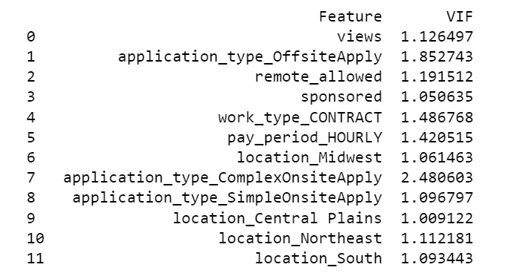
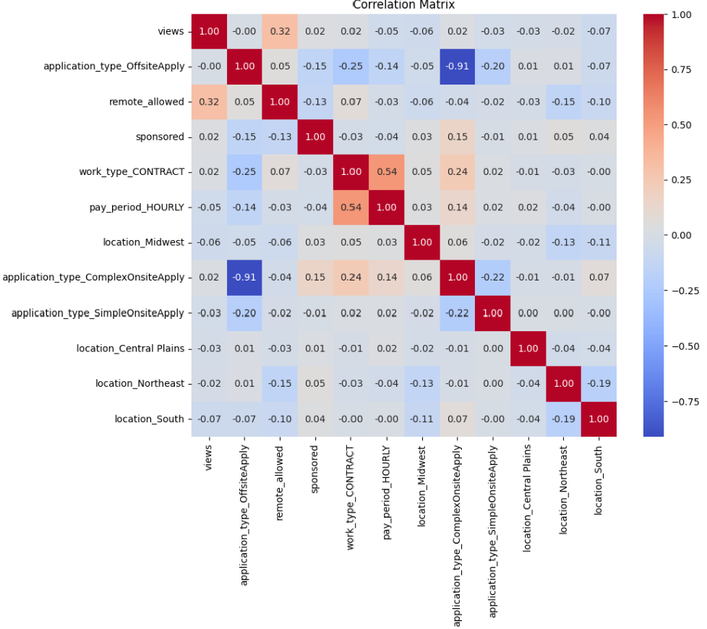
Empirical Methods
Empirical Method: Multiple Linear Regression
Assumption MLR.1. Linear in Parameters - satisfied by the relationship of the independent variables to the dependent variables.
Assumption MLR.2. Random Sampling is satisfied by virtue of the data source and its cross-sectional nature.
Assumption MLR.3. No Perfect Collinearity is satisfied, no perfect collinearity. We can verify it from the correlation matrix
Regression Equation:
Log(applies)=β0 +β1log(Views)+β2 OffsiteApply+β3 RemoteAllowed+β4 Sponsored+β5 ContractWork+β6 HourlyPay+β7MidwestLocation+β8ComplexOnsiteApply+β9 Simple Onsite Apply+β10CentralPlainsLocation+β11NortheastLocation+β12 South Location

Slide 20
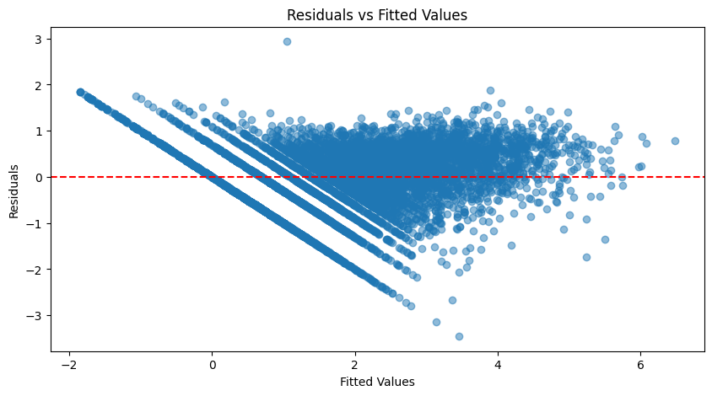
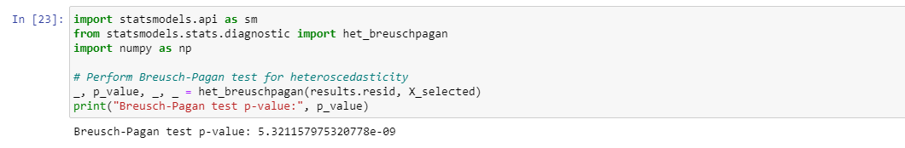
Empirical Methods
MLR.4 Zero conditional mean is reasonably satisfied to have zero conditional mean of the residuals, although there is a slight variation from zero.
Breusch-Pagan test indicates heteroscedasticity is present & MLR.5 Homoskedasticity assumption is not satisfied. We adjusted our standard errors to remain robust against heteroscedasticity using the heteroskedasticity-robust standard errors method, This method is also known as White Standard Errors Method (Economist Halbert White)

Slide 21
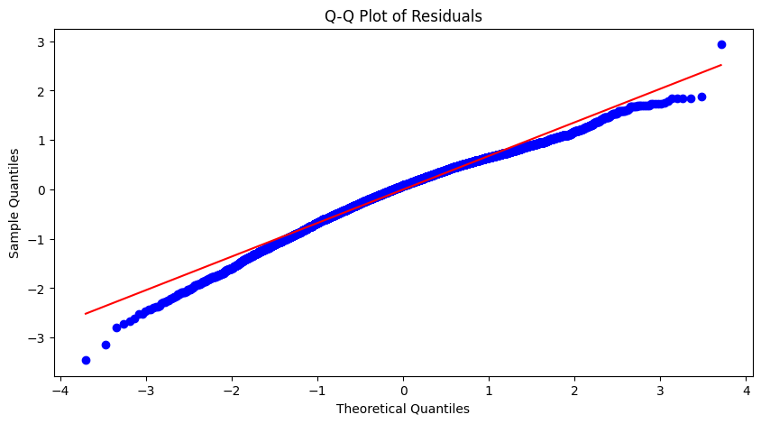
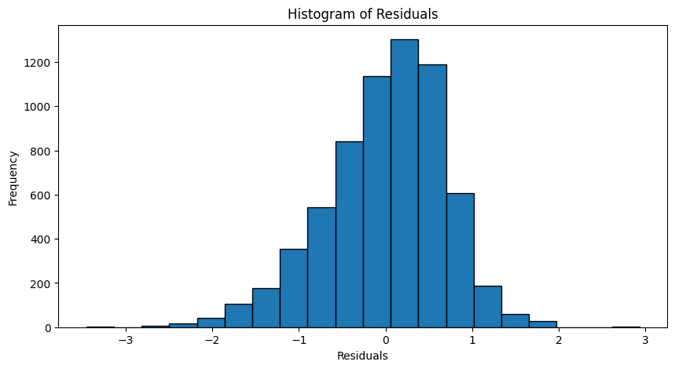
Empirical Methods
MLR.6 Normality assumption is satisfied because our histogram is almost having a bell shape and the distribution of residuals is almost symmetric and not deviating from the expected normal distribution.

Slide 22
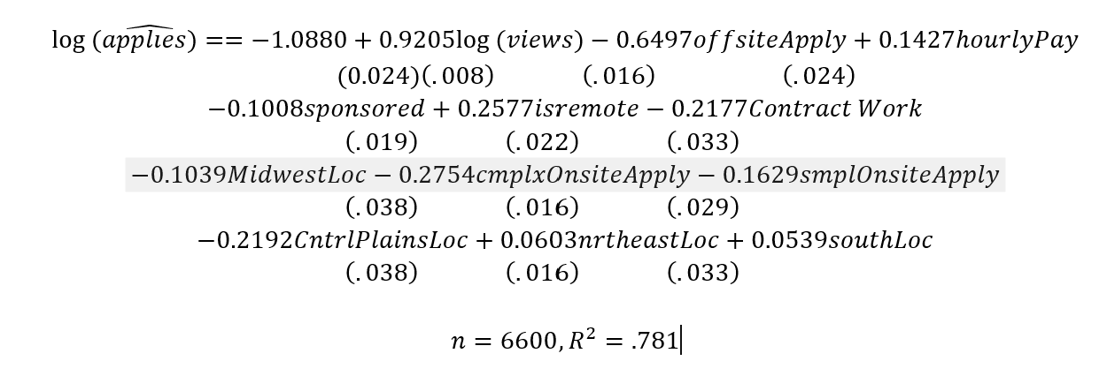
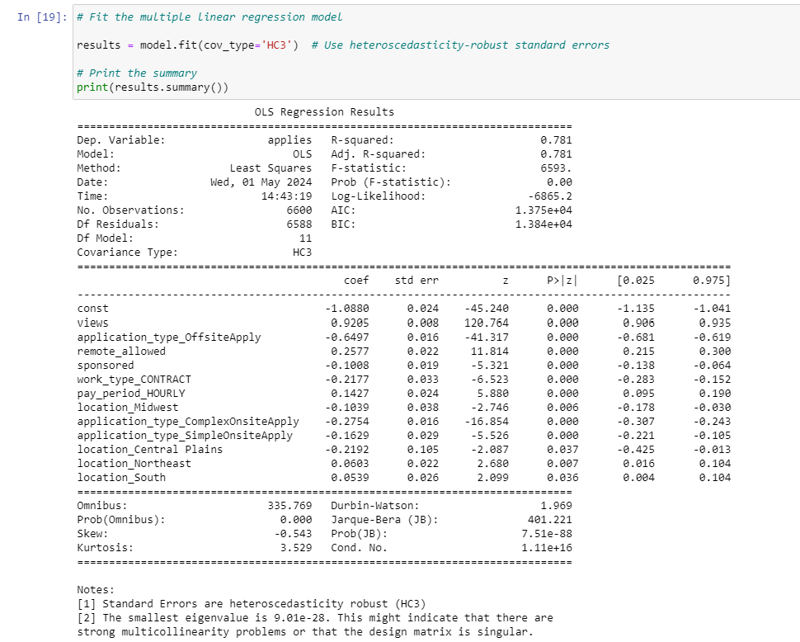
Empirical Methods
Final Estimated Equation:

Slide 23
Training Various ML models & Comparing Model Accuracy Metrics
Model | MAE | MSE | RMSE | R-squared
Linear Regression | 9.948 | 458.706 | 21.417 | 0.766
Lasso | 9.429 | 466.070 | 21.588 | 0.762
Decision Tree Regressor | 11.089 | 985.230 | 31.388 | 0.498
RandomForest Regressor | 9.220 | 571.967 | 23.916 | 0.709
SVR | 9.706 | 855.848 | 29.255 | 0.564

Slide 24
Training Various ML models & Comparing Model Accuracy Metrics
Analysis
Decision Tree Regressor and SVR are clearly underperforming compared to the other models, with higher error rates and lower R-squared values.
Random Forest Regressor shows an improvement in error metrics and R-squared compared to Decision Tree but is not the best among the models listed.
Lasso has a lower MAE than Linear Regression but a slightly higher MSE, RMSE, and slightly lower R-squared.
Linear Regression presents a balance with relatively low error metrics and the highest R-squared among these models, indicating it explains a significant amount of variance in the dependent variable.
Conclusion
Based on the comparison, Linear Regression is arguably the best model among those listed here. It has the highest R-squared, indicating it captures the variance in the dataset well, and its error metrics are comparatively favorable, balancing the trade-offs between complexity and performance effectively. Lasso also performs similarly but with slightly less favorable metrics overall, making Linear Regression the preferable choice for both simplicity and predictive capability.

Slide 25
Key Insights on Factors Influencing Job Applications
Visibility & Job Ad Views
Impact: A 1% increase in views leads to a 0.92% rise in applications.
Why It Matters: Enhanced visibility directly increases the number of potential applicants.
Application Process Efficiency
Offsite Apply: Decreases applications by 65% due to the inconvenience of external processes.
Simple Onsite Apply: Reduces applications by 16.29%, highlighting the need for streamlined processes.
Complex Onsite Apply: Lowers applications by 27.54%, showing a strong dislike for cumbersome procedures.

Slide 26
Key Insights on Factors Influencing Job Applications
Compensation Flexibility
Hourly Pay:
Impact: Boosts applications by 14.27%.
Reason: Hourly roles attract more applicants due to perceived flexibility and accessibility.
Work Arrangement Desirability
Remote Work:
Impact: Increases applications by 25.77%.
Reason: Offers the flexibility and convenience highly valued in today’s job market.

Slide 27
Key Insights on Factors Influencing Job Applications
Role Specialization and Location
Sponsorship: Reduces applications by 10.08%, likely appealing to a narrower, more specialized candidate pool.
Geographic Influence:
Midwest & Central Plains: Sees fewer applications by 10.39% and 21.92%, possibly due to economic and demographic factors.
Northeast & South: Attracts more applications by 6.03% and 5.39%, benefiting from stronger economic conditions and higher populations.
Note: While estimating each of the feature, we are controlling for all other variables in the model.

Slide 28
Conclusion
In summary, (generally speaking) to increase the number of job applications, recruiters should possibly focus on optimizing the visibility and attractiveness of job postings, simplifying the application process, highlighting hourly pay options, carefully considering the inclusion of sponsorship information, and emphasizing remote work opportunities. By implementing these strategies, recruiters can enhance recruitment outcomes and attract a larger pool of qualified candidates.

Slide 29
Q/A

Slide 30
Thank you

